Slide 1



PCF Roadmap
Updated: November 2016

Slide 2
Disclaimer
Note: This is a best estimate of what is coming in future PCF releases, but due to unforeseen circumstances things may change. Please understand this is not meant to represent a promise to deliver a given feature in a given release or timeline.

Slide 3
Updates from PCF 1.8.0

Slide 4

PCF for Azure
Supported in Ops Manager 1.8.10+, ERT 1.8.9+
Tile support includes
PCF Metrics
JMX
RabbitMQ
Redis
Logsearch
Push Notifications
SSO
MySQL
SCS
Diego-Windows/.NET
Azure Service Broker - Service Bus, Event Hub, Blob Storage, DocumentDB, Redis

Slide 5

PCF for Google Cloud Platform
Supported in Ops Manager 1.8.10+, ERT 1.8.5+
Tile support includes
PCF Metrics
JMX
RabbitMQ
Redis
Logsearch
Push Notifications
SSO
MySQL
SCS
GCP Service Broker
Notes:
Changes to ERT to support GCP include native Blobstore support, Some load-balancer changes to ensure zero downtime in rolling deploys, etc.

Slide 6
Garden-runC
Diego has changed from using Garden-linux to Garden-runC
This is the only option moving forward, and became effective in ERT 1.8.8, 1.7.28, 1.6.45
Improved Security: All unprivileged containers now run under AppArmor and seccomp
Significantly reduces impact of any potential exploits in the linux kernel and drastically reduces chances of container breakout.
runC is from the multi-vendor Open Container Initiative (OCI)
runC is the same container runtime used by Docker
This change became effective in ERT 1.8.8, 1.7.28, 1.6.45
Notes:
Very high level description: these are extra layers of security which, in the event of a security issue in the linux kernel being exploited, should prevent or minimise impact by preventing a malicious process from being able to actually do anything outside of the container.
AppArmor is what's called a MAC (Mandatory Access Control) system, comparable/equivalent to SELinux. It puts restrictions on what resources (files, devices, etc.) a specific process is allowed to access.
seccomp is essentially a mechanism to specify which system calls a specific process is allowed to make. We ban from containers from being able to uses any system calls we don't think they should need.
So, if there's a container breakout, these two security systems are there to severely limit what the rogue process can do.

Slide 7
Next Release
December, 2016
Ops Manager
1.9
Elastic Runtime
1.9

Slide 8
Deploying PCF
Ability to control where add-ons get applied
You can now specify jobs that you want the add on to apply too
Updated certificates in Ops Manager
Using self-signed SHA256 rather than SHA-1 for increased security
.NET Core Buildpack included in the default set of Buildpacks

Slide 9
Public Cloud Service Brokers
AWS Service Broker (Beta) - S3, RDS, SQS, DynamoDB
Azure Service Broker - Service Bus, Event Hub, Blob Storage, DocumentDB, Redis
Google Service Broker - Cloud Storage, BigQuery, PubSub, CloudSQL, Machine Learning APIs

Slide 10
PCI Compliance – PCF Add-ons
PCF has all required software for PCI DSS Compliance
IPSec for Encrypted Network Traffic - Available now
Added support for OpenStack, StrongSwan 5.4.0
Operating System hardening - Available now
Anti-virus (ClamAV) - In Active Development
File System Integrity Monitoring - In Active Development
Required Audit information in Logs - Available now
Note: PCF Software is not enough for PCI Compliance, specific installation and configurations must be assessed by a certified assessor

Slide 11
Loggregator
As of PCF 1.8, all metrics were transitioned to Loggregator and the collector was deprecated. As of PCF 1.9, the deprecated job is fully removed.
The Collector job was used for metrics collection prior to the existence of Loggregator, and was still utilized through PCF 1.6.
With PCF 1.7, the majority of metrics had transitioned to the firehose with the exception of some legacy Cloud Controller, (Go)Router, and ETCD metrics which still utilized the collector.
In PCF 1.9, the Collector job is removed completely.

Slide 12
Enterprise Containers
All Apps run as unprivileged Linux containers
“Unprivileged containers are the safest containers”
Root escalation inside the container is no longer a threat to the Host OS
Early-access support for Marketplace Shared Volumes
Supports Docker Volume Plugin Drivers
E.g. NFS or other Network Attached Storage with apps

Slide 13
Security – Pivotal Network Asset Download
Signed assets on PivNet
As an operator, I can verify software from Pivotal Network has not been altered since release and was what Pivotal intended to deliver.

Slide 14
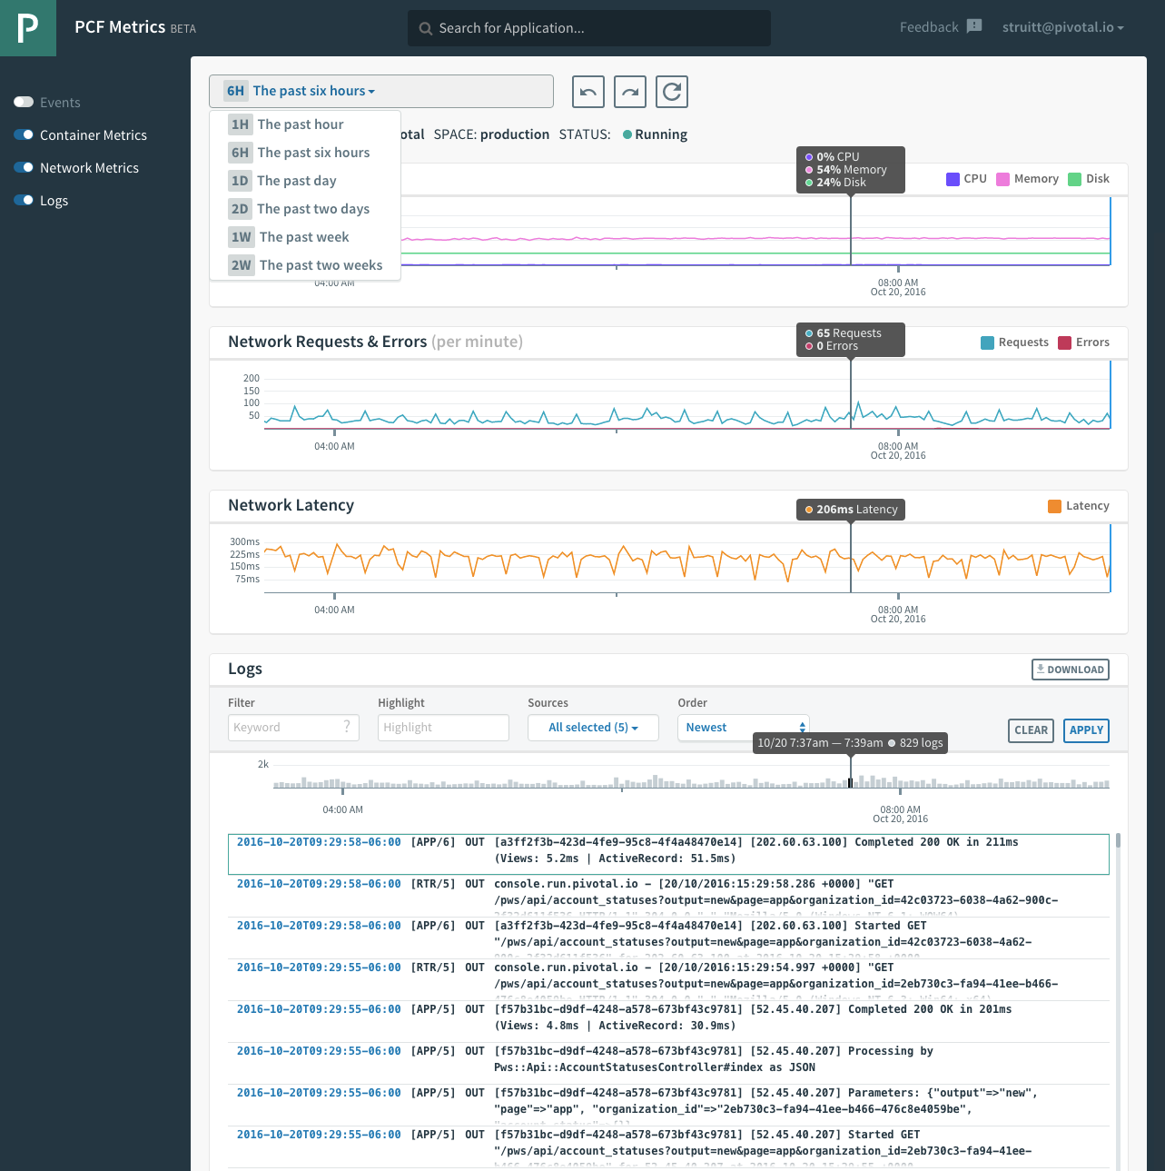
PCF Metrics 1.2
With app events, logs, and metrics in a single UI, developers can:
Monitor health and performance
Visually identify issues
View events, logs, and metrics in context
New PCF Metrics 1.2 features include:
Two weeks of data retention
New user interface with improved interaction and controls
More stable release
https://blog.pivotal.io/pivotal-cloud-foundry/products/troubleshooting-microservices-with-pivotal-cloud-foundry-metrics-1-2

Slide 15
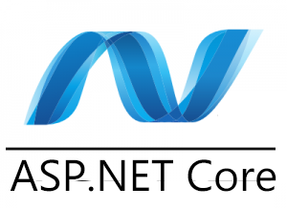
.NET Core Buildpack
New .NET apps run well on Linux
.NET Core buildpack fully supported for Linux
Contributing with Microsoft and IBM
GA was released in October, and is included by default in PCF 1.9

Slide 16


Steeltoe
Steeltoe is a .NET toolkit for common microservice patterns
OSS Project by Pivotal
Spring Cloud Config Server
Service Registration & Discovery with Eureka
.NET Service Connectors for Redis, MySQL, Postgres, RabbitMQ
Supports both .NET Core and .NET 4.x
RC1 Released Oct. 2016

Slide 17

PCF Concourse Tile
Multi-tenant
Developers can provision dedicated Concourse service instances for each CF org/space (pipeline worker pool per space)
Horizontal and Vertical Scalability
Developers can specify size of worker VMs (via plan selection), and #workers for their service instance (for HA scenarios)
Security
User Authentication via UAA (oAuth2) and integration with Concourse Teams (developers can only see/edit pipelines for the orgs & spaces to which they belong)
Timeframe
Private Beta starting in December
GA date will be based on Beta results

Slide 18
Tasks are GA in PCF 1.9
PCF Developers can run one-off processes that cleanly exit with a minimum of resource utilization.
Elastic Runtime can execute a task - a process that is guaranteed to run at most once and automatically exits when complete.
Examples include:
Database migrations
Sending things
Recurring batch jobs
http://v3-apidocs.cloudfoundry.org/version/3.0.0/index.html#tasks

Slide 19
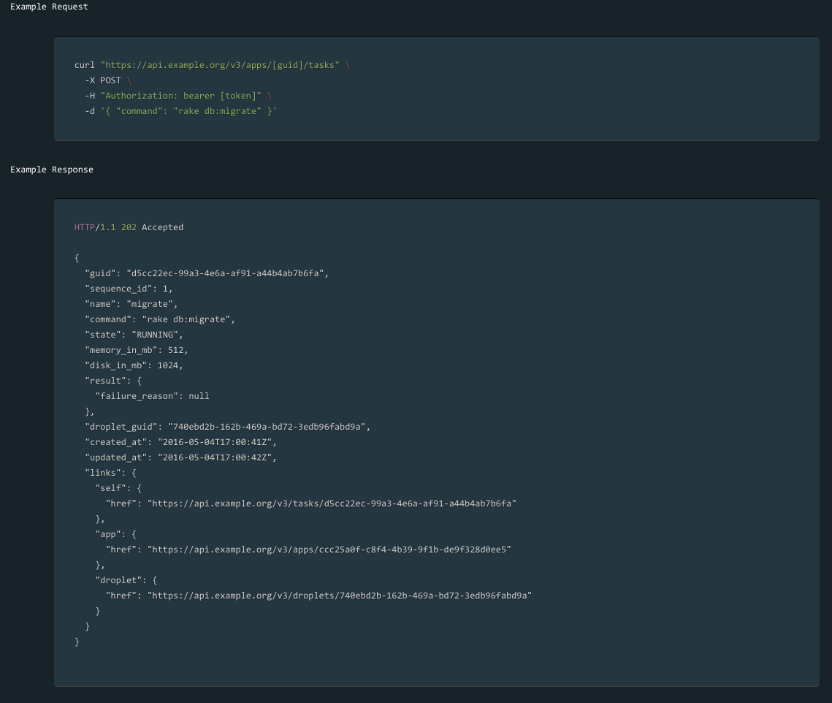
Example Task

Slide 20

Spring Cloud Data Flow for PCF
Batch, Integration and Streaming apps on PCF
Uses CF Task API for short-run processes
Simple composable event-driven data microservices
Smart end-points, dumb pipes
Platform Cron scheduling

Slide 21
Spring on PCF
Runtime users can access information about their spring boot application via a new Apps Manager dashboard.
Apps Manager can display health, info and logging information unique to a Spring Boot App
Access to this information is based on a user's identity in Elastic Runtime with respect to access to ORG/Space where the App is deployed and their user role

Slide 22
PCF Vision for Zipkin
Zipkin is being adopted by many programming communities to provide distributed tracing for (RPC) across components.
Spring Cloud Sleuth is a library that adds Zipkin tracing support very simply to Spring Boot applications.
Many PCF customers, including virtually all customers using Spring have applications that span multiple interconnected components. First-class distributed-tracing support enables these customers to more effectively understand performance and troubleshoot their applications.
With feature enhancements to PCF Metrics and GoRouter, we can propagate Zipkin Trace information in CF logs and displaying logs and metadata related to a Zipkin Trace in PCF Metrics.

Slide 23
PCF Support for Zipkin
Developers can can better understand performance and troubleshoot distributed spring boot applications running in PCF by utilizing zipkin tracing and span IDs.
Runtime Router access logs related to a given App include the span and trace ids in the HTTP header of the request in order to correlate events
Runtime Router can generate and append span, parent span and trace IDs to HTTP headers when forwarding traffic to applications in order to generate an useful series of Zipkin events
http://www.slideshare.net/MarcinGrzejszczak/microservices-tracing-with-spring-cloud-and-zipkin-61942031/1

Slide 24
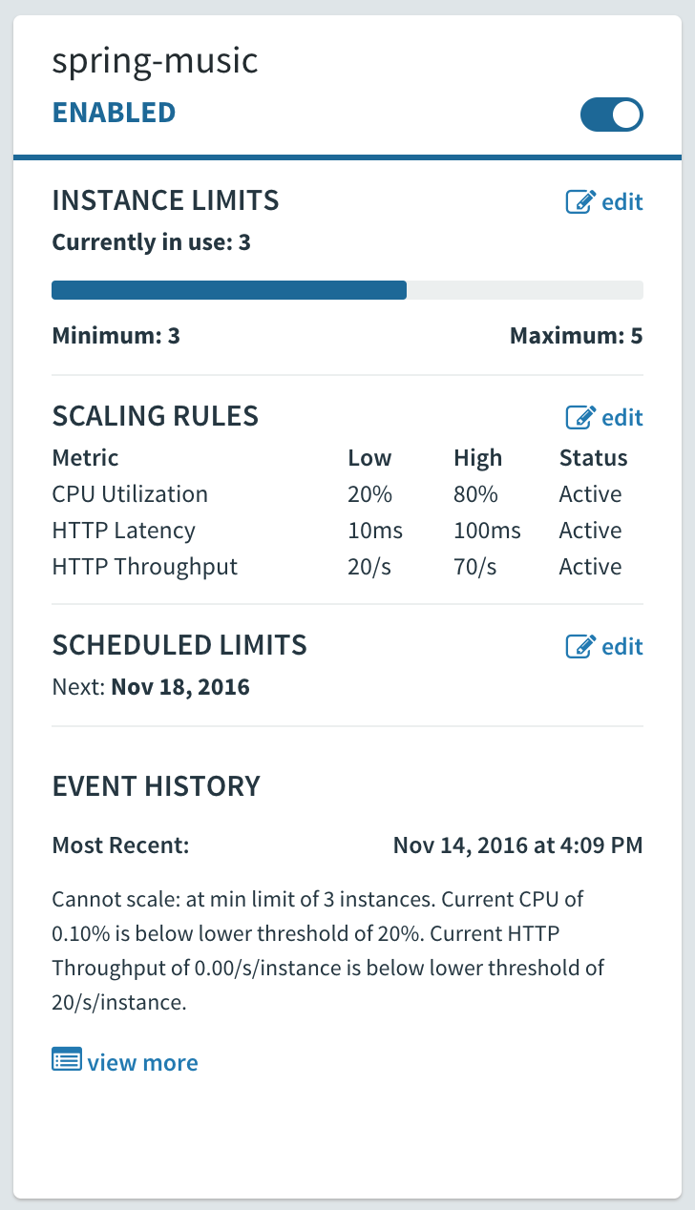
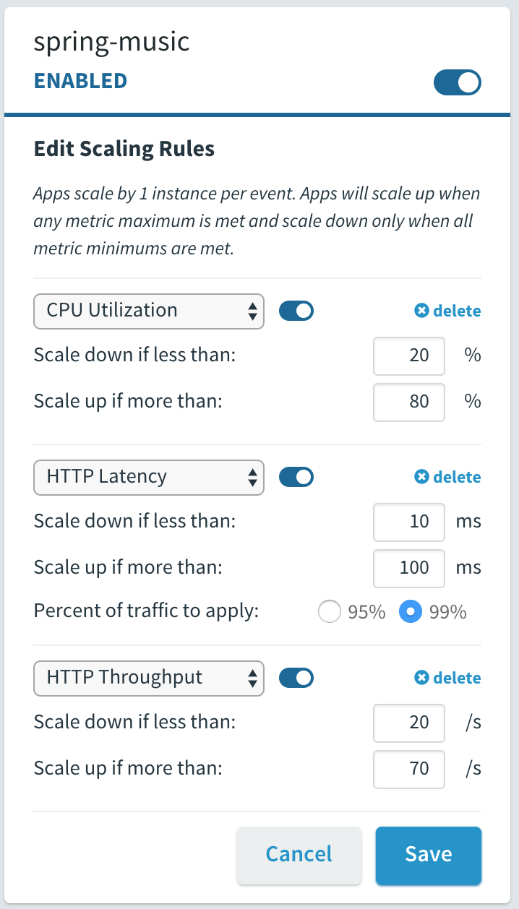
App Autoscaling Enhancements
API to configure Autoscaling
Enables CI/CD pipeline-based configuration
Scriptable, REST-based API http://docs.run.pivotal.io/appsman-services/autoscaler/api/
New Trigger Metrics for Autoscaling Rules
HTTP Throughput
# of HTTP Requests / Second ➗ App Instances
HTTP Latency (99% / 95%)
App response latency (average time it takes for the request to go from the GoRouter to the App and back)
CPU Utilization
Existing metric but used to be point in time calculation
All 3 metrics are now rolling avg. over 30 seconds
Rules are evaluated every 5 seconds (not 5 minutes)
Scaling is limited to 1 AI at a time, and once every 30 seconds
Supports multiple metrics per app
Notes:
This version of App Autoscaling is a collection of enhancements to existing features.
Availability: Live in PWS as of November, slated for release with PCF 1.9
Roadmap: CLI integration will likely be a quick follow-on, future integration with PCF Metrics will open up many more trigger metrics
Note: Scheduled scaling functionality still supported (ex. Scale your app down on Friday night and back up on Monday morning)

Slide 25
Services
Redis
1.7
December 2016
MySQL
1.8
January 2017
RabbitMQ
1.8
December 2016
Gemfire
2.0
February 2017
Spring Cloud Services 1.3.0
November 2016

Slide 26
Pivotal Services SDK
Reusable components to be used by all services teams
Includes docs, examples and guides
Used by Global Ecosystem, Pivotal partners, customers and internal teams
Features:
On Demand Broker
Backups
Metrics

Slide 27
Redis
Ready to use, high speed key value store that includes
IPSEC support and Operational Monitoring.
Customers today are using redis as a Database, Cache and Message Broker.
Redis supports a range of data structures including strings, lists, hashes, sets, bitmaps, hyperloglogs and geospatial indexes.

Slide 28
Redis
Almost Complete (1.7):
Backup and Restore
Revamped Docs
Coming Soon Q1:
On-demand Plans (S/M/L, datastore/cache)
Customizable Plans (VM type, plan name/description, config settings, enabled/disabled)
Service instance Quotas
Customizable Instances (by arbitrary parameters, inc maxmemory-policy)
Plan Migrations
Scale Testing
Hide dedicated VM Plan
Defensive measures (e.g. connection limits)

Slide 29
RabbitMQ
Common Use Cases
Spring integration (Cloud bus and passing messages)
Intra CF App messaging
Easy to deploy and manage messaging service, conforming to the industry standard AMQP

Slide 30
RabbitMQ
Current Focus on:
Upgrade reliability
Increasing logging for each stage
Introducing startup checks
Introducing a drain script
IPSec support
Learning how RabbitMQ behaves with bosh and with customers
Operating RabbitMQ in Action
PWE - multi-tenant with SCS
PWS - on-demand broker
HA for a caching service is not a focus let’s discuss why.

Slide 31
RabbitMQ
Almost Complete (1.8):
Single node ODB clusters (available now on PWS)
Data encryption
TLS for RabbitMQ (different subnet to IPSEC)
Coming Soon:
Customizable Plans
Mutual TLS within Transmit

Slide 32
MySQL
The MySQL for PCF product delivers a fully managed, “Database as a Service” to Cloud Foundry users.
The tile deploys and maintains a single or three-node cluster running a recent release of MariaDB, SQL Proxies for super-fast failover, and Service Brokers for Cloud Foundry integration.
Developers can attach a database to their applications in as little as two commands, cf create-service and cf bind-service.
Developers can select from a menu of service plans options, which are configured by the platform operator.

Slide 33
MySQL: 1.8Edge
MySQL now balances across availability zones if provisioned with a network that has multiple subnets.
MariaDB updated to version 10.1.17 and Galera 25.3.17.
Includes a new long-running monitor, the Replication Canary. The Replication Canary continually monitors the MySQL cluster, watching for instances where cross-cluster replication has failed. It is enabled by default with more information available here.
The MySQL nodes have new logic (the Interruptor) that, when enabled, prevent a node from re-joining a cluster under certain conditions. This is a second level of protection against the possibility of data loss.

Slide 34
MySQL: 1.8Edge
Backing up all nodes: there is now an option to take backups from all MySQL nodes. This feature protects users from possible data loss when some nodes have different data than the others.
Logging Changes
MySQL job logs are kept local on the VM, in addition to being sent to syslog if configured.
Binary logs are now enabled and rotated automatically by the system.
Audit logs are now enabled, and automatically configured by the system.
Audit logs are not transmitted to syslog, due to the sensitive nature of the content of the audit logs.
Multiple debug log changes have been added to aid in diagnosis efforts.

Slide 35
Gemfire for PCF
Provides a way to deploy “generic” GemFire clusters through PCF / BOSH. That’s pretty much it. Developers can deploy apps on PCF and talk to the clusters “easily.”
Assumes client/server paradigm, but provides WAN-gateway config.
Provides one member per VM.
Operators create a “pool” of VMs; developers consume them through creating “services instances” with cf create-service.
Workflow after creating the cluster is the same as any other GemFire cluster. The CLI plugin provides the URLs you need for WAN-gateway and gfsh.

Slide 36
Gemfire 2.0 Beta for PCF
For operators:
Day-2 operations
Backups (for plans w/ persistence)
Customizable service plans
Better logging and metrics
Instance quotas
Smoke tests and canaries
Access controls
Reliable upgrades
For app developers:
Get started with GemFire quickly and easily with a cluster, using best-practice settings that Pivotal recommends and supports.
Spring!
On-demand provisioning
Supporting GemFire 9, which offers:
Improved performance - New security features
Off-heap storage for PB scale

Slide 37
Spring Cloud Services
Spring Cloud Services builds on the foundation of Spring Boot and Spring Cloud to simplify crucial patterns for microservices running on Pivotal Cloud Foundry. SCS includes a collection of services for developers who don’t want to implement, deploy, maintain, and upgrade their own Spring Cloud services. With SCS, developers can focus on delivering business value, while Pivotal secures, maintains, and operates these components. Spring Cloud Services includes:
Config Server - an externalized application configuration service
Circuit Breaker Dashboard - an implementation of the Circuit Breaker pattern
Service Registry - an implementation of the Service Discovery pattern

Slide 38
Spring Cloud Services
Recently Released:
1.2: Multi-site Service Discovery & Enhanced Blue/Green Deployment Support
1.3: Spring Cloud Camden.SR2 Support
Upcoming Target Capabilities
1.3.1: Deploy multiple versions of SCS tile into single PCF foundation & Enhanced PWS integration/monitoring
1.4: Config Server HashiCorp Vault integration

Slide 39
In Progress - Coming Soon

Slide 40
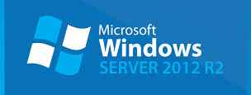
BOSH-Windows
Reduce operating burden for Windows cells in PCF
Enables all the BOSH-provided support for Windows cells in addition to Linux
Repave, VM scaling, VM recreation, etc
Early access available now, GA in 1.9.x
Targeting AWS
Please contact us for interest on Azure, GCP, or vSphere
Support for Windows 2012R2 (and soon 2016)
IPsec not yet supported

Slide 41
Container Networking
New experimental capability that may make PCF ERT v1.9
Functional and ready for evaluation and feedback
Not recommended to rely on this capability in production yet
Future versions of ERT may not be backward compatible WRT this capability
Operators enable or disable the capability when deploying Elastic Runtime.
Elastic Runtime Administrators specify which of their containers can directly communicate with one another
# cf allow-access SOURCE_APP DEST_APP --protocol <tcp|udp> --port [1-65535]
# cf list-access
# cf deny-access SOURCE_APP DEST_APP --protocol <tcp|udp> --port [1-65535]

Slide 42
Container Networking
Provides a “batteries-included” container networking solution
All containers are connected to a single, system-wide routed (L3) IP network.
All containers have a single network interface and a single IP address on the overlay network
Communication between applications is controlled by policy
Changing policy does not require an application restart
Policy configuration is restricted to users with a network.admin scope
The CF Router continues to reach app containers via NATed ports on Diego cells
Policy is configured through a CF CLI (requires plugin) or external API

Slide 43
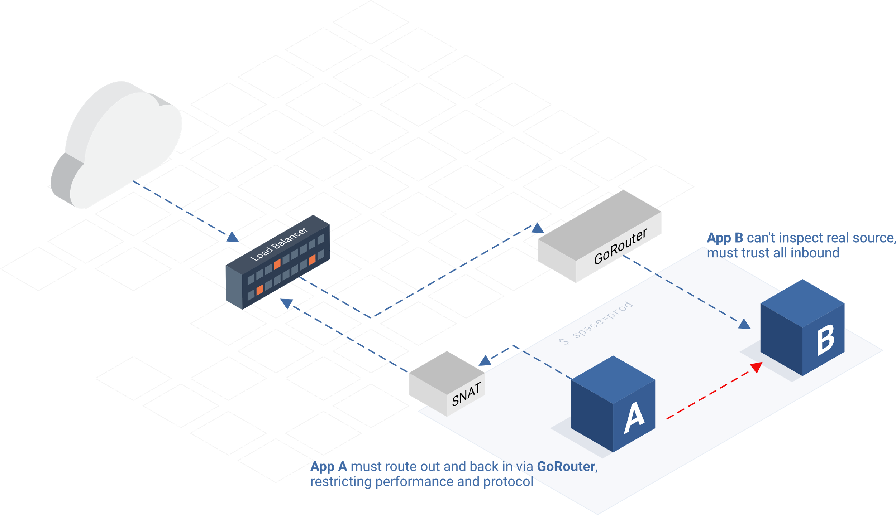
Without Container Networking: Today

Slide 44
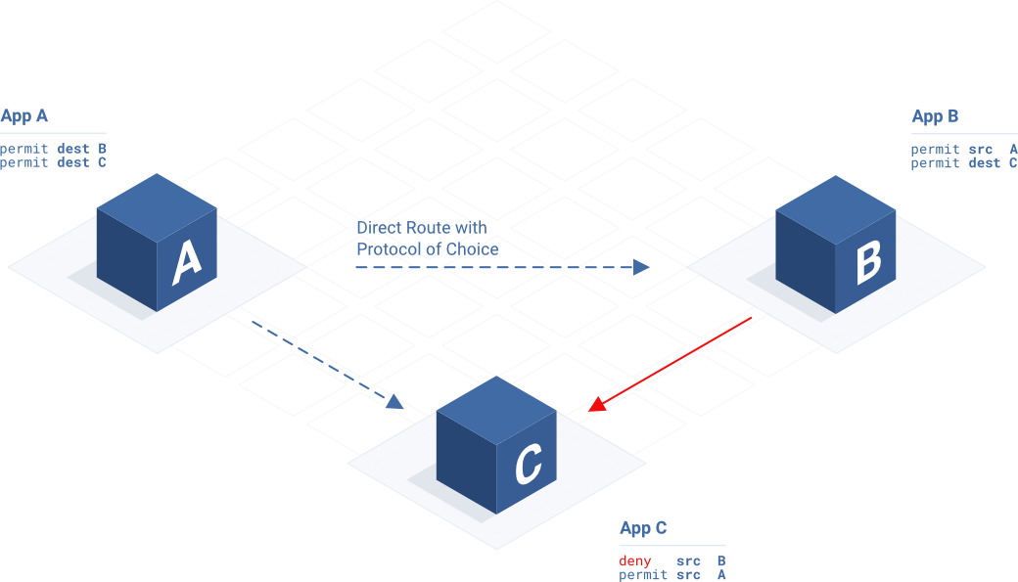
Container Networking

Slide 45
Container Networking: Longer Term
Space developers can configure network policy for their apps
Network policy for connectivity from app containers to services (e.g. only App A may reach this service instance)
Direct layer-3 connectivity from the CF Router to apps (no more DNAT / port forwarding)
https://www.cloudfoundry.org/meet-new-container-networking-stack-cloud-foundry/

Slide 46

3 R’s of Enterprise Security
Vision articulated by Justin Smith's Medium post
Repair - Strong track record of CVE turn-around
Major/Critical CVEs patched with patch target of 2 business days
Low/Medium CVEs patched monthly into stable releases
AppDog: Report of App Dependencies, Vulnerabilities & Licenses
Repave - 2H 2016
Continually rebuild VMs from known-good configurations
Rotate - 2H 2016
Continually rotate credentials with secure credential storage

Slide 47
Deploying PCF (Coming Soon)
Exposing Ops Manager API endpoints to support automation
Ability to repave Runtime
Ability to repave other deployments

Slide 48
Elastic Runtime
Diego BBS to mysql (more stable solution)
Container to Container Networking (experimental)
PCF ERT support deploying Windows cells
Containers are unprivileged as default
Zipkin consumption if not through metrics
Routing API information to mysql
Containers now unprivileged for additional security

Slide 49
PCF Application Watchdog (AppDog)
PCF Developers can obtain a report detailing:
Application dependency metadata:
Dependency name
Dependency version
Dependency newest version available
Dependency OSS License
PCF Developers can receive notifications when:
An application dependency contains a security vulnerability
An application dependency has a newer version available

Slide 50
Security – CredHub
Central credential management store focused on BOSH manifest credentials
Ability to generate and supply from store
When deploying, the operator does not see the credentials. They are bound to the manifest at some point later in the processing of the manifest.
The manifest with populated credentials is never stored on disk on the director

Slide 51
Partnerships

Slide 52
SPLUNK + PCF
Splunk started out a Google for Log Files,
it can store all your logs and provide search capability
BOSH managed Splunk heavy forwarder co-located with a firehose nozzle (wrapped in a tile)
The nozzle is based off of firehose-to-syslog and will behave quite similarly
The ingested event types will be configurable
It will optionally make the API calls to cloud-controller to enhance app specific events with additional metadata (app name, org-id, space-id)
A pre-built Splunk dashboard that an operator can install and customize (a Technical Add-on in Splunk terminology)
Ingestion is just the firehose data for first release
Targets System Operator Use Case
Development is complete, legal is finalized, available in Dec (beta).

Slide 53
SPLUNK + PCF
How is this better than using the firehose-to-syslog ingesting into SPLUNK?
The intermediate step of setting up and managing a syslog server isn't required.
The syslog data doesn't require any custom parsing to separate the json payload from the common syslog output.
Event type is set based off of nozzle event type
There should be less risk of message loss, since HA needs are addressed by spinning up multiple BOSH nodes of the nozzle/forwarder rather than relying on disk output for a syslog server.
It's all packaged in a tile.

Slide 54
SPLUNK + PCF
What is not included in this first release?
Some of these events are application specific, but there's no permission mapping from Cloud Foundry to Splunk. There's no way to say "This cloud foundry user should be able to see their apps events in Splunk".
There's no way to opt in to events per-app, only all app specific events. Splunk charges by volume, and every customer is doing this differently today.
The syslog specific data and the both health data aren't part of this, but an operator would likely want this data. These are near the top of the Loggregator Roadmap but aren’t yet included in the firehose.

Slide 55

Thank you

Slide 56
Long Term View - Large Feature Commitments
Gemfire ODB can provide a front-end cache
SCDF GA can run batch jobs in PCF
2 weeks of Retention and Zipkin Correlated Logs in PCF Metrics
Container Networking with Application ID on packet
Less-Lossy Loggregator
Isolation Segments
Backup and Restore
Autoscaling should leverage additional metrics
Redis ODB in PCF
Establish PWS-Europe on top of GCP
AppDog Monitoring Application Dependencies
Users can provide custom application health checks
Provide a compiler-less production foundation
Ship Concourse Tile
.Net Core Buildpack Support
Improved Docker Support
PCF Supports GCP and Azure
Resolve MariaDB Data Loss by Shipping MariaDB 10.1 with Data-Loss Guards
Work through Big Bank Security Report: Phase 2
PCF BOSH
Security: Finish PCI Compliance Items, Code Signing
Windows support for BOSH
Spring Boot Dashboard
Repave in PCF
Improve release times, upgrade testing, early integration/C0 across supported IaaSes
Finish: Diego Scale, Garden-RunC, Unprivileged Containers
CredHub: Service Credential Encryption
CredHub: Rotate Diego credentials in PCF BOSH
RMQ ODB in PCF
MySQL Leader/Follower ODB in PCF

